Slide 1


Advisor : Hoon Sung Chwa
Weekly Meeting
25.07.10.
Dept of Electronic Engineering & Computer Science, DGIST
Real-Time Computing Lab
Moonyoung Choi (cmy021205@dgist.ac.kr)
Notes:
Weekly meeting 표지

Slide 2
Goal
Goal: Analyzing Latency in Autonomous Drone Navigation via Offboarding
Requirement:
Understanding the Logic of Autonomous Drone Navigation via Offboarding
Analyzing Latency at Each Stage of the Process
MAVROS Communication Flow
Testing ROS Topics Required for Latency Measurement and Autonomous Navigation
2

Slide 3
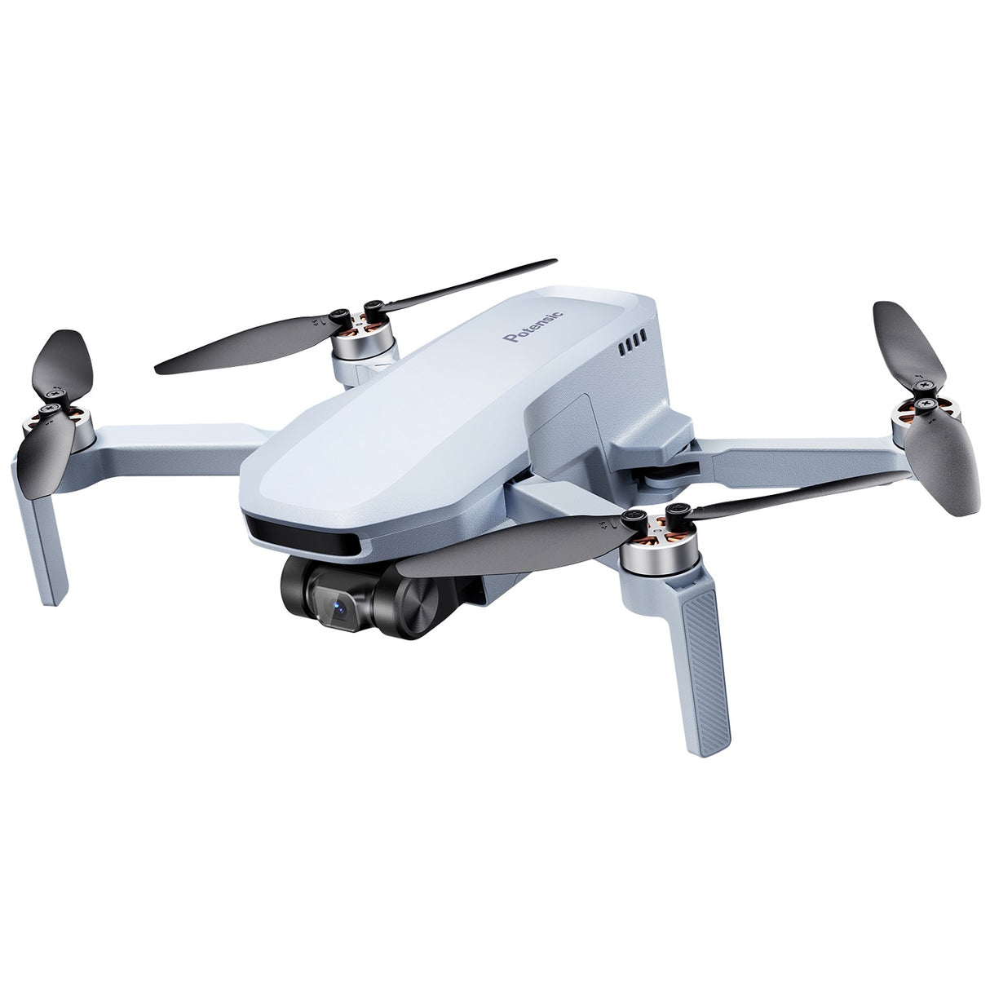
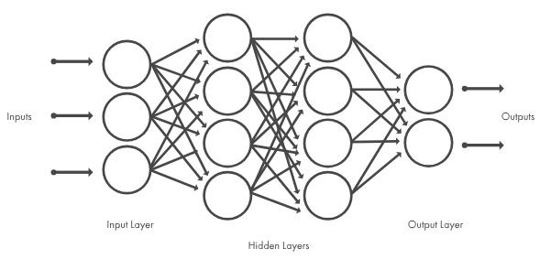
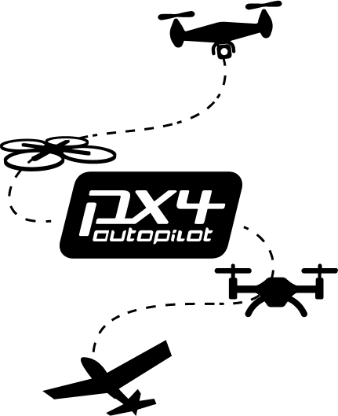


Intro
Analyzing Latency in Autonomous Drone Navigation via Offboarding
onboarding
offboarding
3

Slide 4

Intro
Analyzing Latency in Autonomous Drone Navigation via Offboarding
keep-alive message
(offboard mode 유지)
non-ROS app
4

Slide 5
Background(Onboarding & Offboarding)
On-boarding
Off-boarding
PX4 SITL
hardware 역할
Gazebo
Simulator
PX4: 드론 제어 펌웨어
MAVLink: UAV 통신 protocl
MAVROS: DDS↔MAVLink 변환
ROS2
ros2 node
message pub
MAVROS
mavros node
DDS to MAVLink
PX4 SITL
hardware 역할
Gazebo
Simulator
Latency 발생
5

Slide 6
MAVROS Node
Topic vs Service
 | Topic | Service
Communication | Publisher-Subscriber | Request-Response
Activation | 지속적인 데이터 | 일회성 명령
목적 | Data Flow | Command (by user)
활용 예시 | 센서, 위치, 상태 | 작업 명령
6

Slide 7
Background(Offboarding Mechanism)
MAVROS 통신 구조
ROS 2
일회성 명령
service call
MAVROS
/mavros_node
Node 1
/cmd/arming
Node 2
/cmd/takeoff
x: 1.0
y: 1.0
z: 5.0
Node 3
/cmd/set_mode
현재 드론
상태
지속적인 명령
Topic 1
/cmd/set_posi
PX4 SITL
topic pub
x: 1.0
y: 1.0
z: 5.0
Node 4
/cmd/set_posi
현재 드론
상태
keep-alive message
(offboard mode 유지)
Node 5
/cmd/battery
Topic 2
/cmd/state
7

Slide 8
MAVROS Node
MAVROS Node 구조
ROS2
MAVROS Node
최종 Queue
Service
Plugin
PX4 SITL
Service
Plugin
일회성 명령
Service
Plugin
Service
Plugin
Topic
Plugin
Topic
Plugin
지속적인 명령
Topic
Plugin
Topic
Plugin
8

Slide 9
MAVROS Node
Service 명령: 일회성
mavros_node.cpp → … → send_message()
Topic 명령: 지속적
mavros_node.cpp → … → send_message()
최종 queue:
Priority queue 구현하기
Topic 명령의 priority를 낮추기
code 수정할 때마다 colcon build…
send_message() 함수 호출 순서대로
topic | topic | topic | service | topic | topic
9

Slide 10
MAVROS vs uXRCE
Question: MAVROS의 범용성?
MAVROS vs uXRCE 비교
목적: PX4와 ROS2 간의 통신
 | MAVROS | uXRCE
구조 | PX4 ↔ MAVROS ↔ ROS2 | PX4 ↔ ROS2
지연 | MAVLINK ↔ ROS2 | 낮음
기능 | 자율주행 등 다양한 미션 가능 | 제한적(개발 중)
실시간성 | 낮음 | 높음(RTPS 기반)
안정성 | 높음 | 낮음(개발 중)
통신 방식 | MAVLINK ↔ ROS2 | DDS 기반
특징 | 다른 관련 어플과의 연계 | 아직 개발단계
10

Slide 11

Advisor : Hoon Sung Chwa
Thank you
Dept of Electronic Engineering & Computer Science, DGIST
Real-Time Computing Lab
Moonyoung Choi (cmy021205@dgist.ac.kr)

